Slide 1


<Name>
<Date>

Slide 2

Outline
Executive Summary
Introduction
Methodology
Results
Conclusion
Appendix

Slide 3
Executive Summary
Key Results
The analysis revealed several important findings:
Launch Site Success: The CCAFS LC-40, VAFB SLC-4E, and KSC LC-39A launch sites had varying rates of success, with improvements noted over time.
Payload Mass: Successful landings occurred across a wide range of payload masses, demonstrating SpaceX's ability to handle diverse missions.
Orbit Success Rate: Missions to ES-L1, GEO, and HEO orbits had a 100% success rate, while other orbits like GTO had a lower success rate of about 50%.
Success Over Time: The success rate of launches showed a clear upward trend, rising from 0% between 2010 and 2013 to over 80% by 2017.
Model Performance: All four machine learning models—Logistic Regression, SVM, Decision Tree, and KNN—achieved similar high accuracy scores. The confusion matrix for one of the models showed a high number of correctly predicted successful landings.

Slide 4
Executive Summary
Executive Summary
This project analyzed SpaceX launch data to create a predictive model for Falcon 9 first-stage landing outcomes. The methodology involved several key data science steps. First, data was collected using web scraping from a Falcon 9 Wiki page and the SpaceX API. Next, data wrangling was performed to handle missing values and define mission outcomes as successful or unsuccessful landings. Exploratory data analysis (EDA) was conducted using data visualization and SQL queries to find relationships within the data. An interactive dashboard with Plotly Dash was built to visualize the data and a Folium map was created to mark launch sites. Finally, predictive analysis was performed using several classification algorithms, including logistic regression, support vector machine (SVM), decision tree, and K-nearest neighbors (KNN).

Slide 5
Introduction
Project Background and Context

Slide 6

Section 1

Slide 7
Methodology
Data Collection & Wrangling: How can launch data be collected from both public APIs and web scraping? How can missing values be handled and the data be structured for analysis?
Exploratory Data Analysis (EDA): What are the key relationships between variables such as Flight Number, Payload Mass, and Launch Site? How do these factors correlate with a mission's success?
Visual Analytics: How can interactive maps and dashboards be created to visualize launch sites and mission outcomes?
Predictive Analysis: What machine learning model can best predict the outcome of a first-stage landing based on mission characteristics?
Model Evaluation: How do the different classification models (e.g., Logistic Regression, SVM, Decision Tree, KNN) compare in terms of accuracy?

Slide 8
Data Collection
The SpaceX launch data was collected using a two-part process. First, a
GET request was used to request and parse data from the SpaceX launch API. The resulting dataframe was then
filtered to include only Falcon 9 launches. Second, the
Falcon 9 Launch Wiki page was requested from its URL. Column and variable names were
extracted from the HTML table header , and a new dataframe was created by
parsing the launch HTML tables. This process is followed by a
Data Wrangling step, which includes dealing with missing values.

Slide 9


Data Collection – SpaceX API
https://github.com/rafaelrade/ScienceDataExercise/blob/main/01_Data_Collection.ipynb

Slide 10
Data Collection - Scraping
https://github.com/rafaelrade/ScienceDataExercise/blob/main/02_Webscraping.ipynb

Slide 11







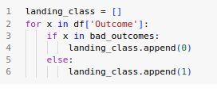
Data Wrangling
https://github.com/rafaelrade/ScienceDataExercise/blob/main/03_Data_Wrangling.ipynb

Slide 12


EDA with Data Visualization
https://github.com/rafaelrade/ScienceDataExercise/blob/main/04%20EDA_visualization.ipynb

Slide 13
EDA with SQL
https://github.com/rafaelrade/ScienceDataExercise/blob/main/05_EDA_SQL.ipynb
Names of the unique launch sites in the space mission
5 records where launch sites begin with the string 'CCA'
total payload mass carried by boosters launched by NASA (CRS)
average payload mass carried by booster version F9 v1.1
date when the first succesful landing outcome in ground pad was acheived.
names of the boosters which have success in drone ship and have payload mass greater than 4000 but less than 6000
total number of successful and failure mission outcomes
booster_versions that have carried the maximum payload mass, using a subquery with a suitable aggregate function.
records which will display the month names, failure landing_outcomes in drone ship ,booster versions, launch_site for the months in year 2015.
count of landing outcomes (such as Failure (drone ship) or Success (ground pad)) between the date 2010-06-04 and 2017-03-20, in descending order.

Slide 14
Build an Interactive Map with Folium
Mark all launch sites on a map
Mark the success/failed launches for each site on the map
Calculate the distances between a launch site to its proximities
https://github.com/rafaelrade/ScienceDataExercise/blob/main/06_FOLIUM.ipynb

Slide 15
Build a Dashboard with Plotly Dash
Summarize what plots/graphs and interactions you have added to a dashboard
Explain why you added those plots and interactions
Add the GitHub URL of your completed Plotly Dash lab, as an external reference and peer-review purpose

Slide 16
Predictive Analysis (Classification)
Create a NumPy array
Standardize the data
split the data X and Y into training and test data
logistic regression
support vector machine
decision tree classifier
k nearest neighbors
Methods Comparison
https://github.com/rafaelrade/ScienceDataExercise/blob/main/08_Machine_Learning.ipynb

Slide 17
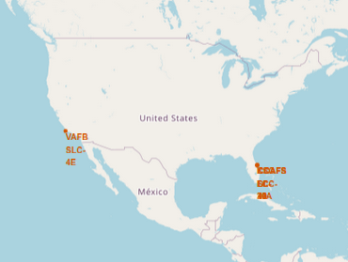
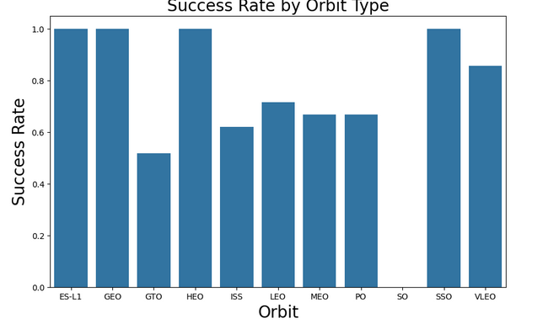
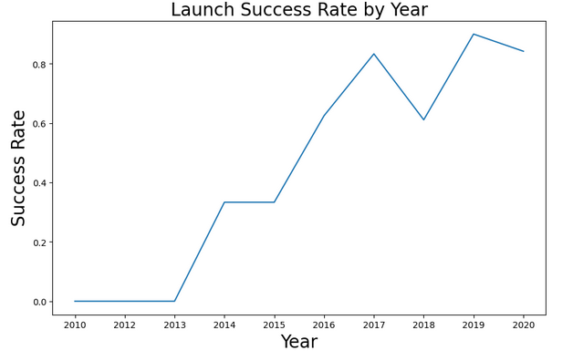
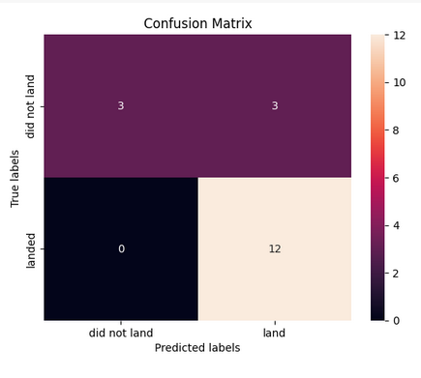
Results

Slide 18

Section 2

Slide 19
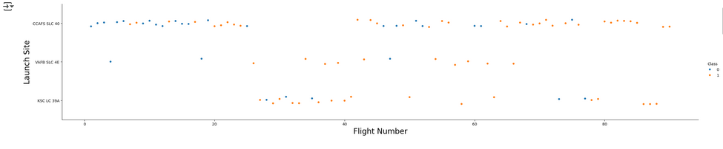
Flight Number vs. Launch Site
This graph displays the success and failure of SpaceX Falcon 9 launch attempts across different launch sites over time.
Each point represents a single launch, with the x-axis indicating the Flight Number (chronological order of launches) and the y-axis showing the Launch Site.
The launches are color-coded by Class: blue dots (Class 0) represent unsuccessful landing attempts, while orange dots (Class 1) represent successful landing attempts.
The visualization reveals that early flights had a higher rate of failure, but over time, particularly for later flights, SpaceX significantly improved its success rate, especially at sites like CCAFS SLC 40 and KSC LC 39A.

Slide 20
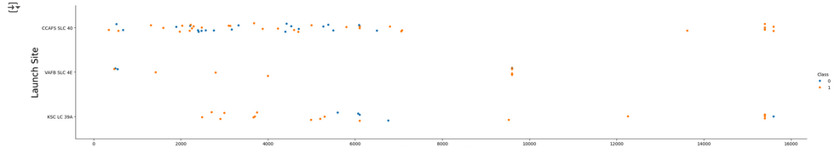
Payload vs. Launch Site
This graph, which appears to be a scatter plot, displays the success of SpaceX Falcon 9 launches in relation to the Payload Mass (kg) for different Launch Sites.
The y-axis represents the launch site, while the x-axis shows the payload mass in kilograms. Each point on the graph corresponds to a single launch, with its color indicating the outcome: blue dots (Class 0) signify an unsuccessful landing, and orange dots (Class 1) denote a successful landing.
The visualization suggests that successful landings occurred across a wide range of payload masses, and at all three launch sites. The successful launches seem to become more frequent as the mission progressed.

Slide 21
Success Rate vs. Orbit Type
This bar chart displays the success rate of SpaceX missions for various orbit types. The x-axis represents the different types of orbits, while the y-axis shows the success rate, ranging from 0.0 to 1.0.
The graph reveals that SpaceX has a 100% success rate for missions targeting ES-L1, GEO, and HEO orbits. Missions to GTO have a success rate of about 50%, while SSO also has a perfect 100% success rate.
The success rates for other orbits like ISS, LEO, MEO, and PO are notably lower, falling between 60% and 80%. This visualization clearly illustrates how mission success can vary significantly depending on the orbital destination.

Slide 22
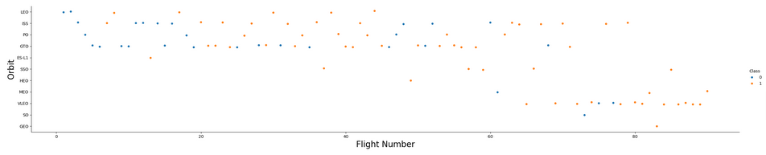
Flight Number vs. Orbit Type
This scatter plot shows the relationship between Flight Number, Orbit type, and the success of SpaceX missions.
The x-axis represents the chronological order of the launches (Flight Number), and the y-axis shows the type of orbit achieved.
Each point on the graph corresponds to a single launch, with its color indicating the outcome: blue dots (Class 0) represent unsuccessful missions, while orange dots (Class 1) represent successful ones.
The visualization highlights that early flights (low flight numbers) had a mix of successes and failures across various orbits.
Over time, as SpaceX gained experience (higher flight numbers), the number of successful missions, particularly those in GTO, SSO, and VLEO, appears to increase significantly, demonstrating the company's improvement in mission reliability.

Slide 23
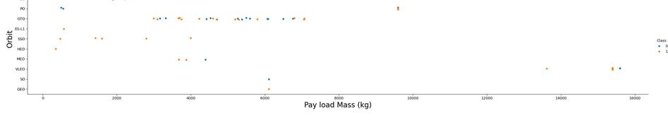
Payload vs. Orbit Type
This scatter plot illustrates the relationship between Payload Mass and Orbit type for SpaceX missions, with the outcome of each mission indicated by color.
The x-axis represents the payload mass in kilograms, while the y-axis shows the specific orbit type.
Each point on the graph is a single launch, with blue dots (Class 0) indicating an unsuccessful mission and orange dots (Class 1) indicating a successful one.
The visualization suggests that successful missions, represented by the orange dots, have been achieved across a wide range of payload masses and orbit types, including GTO, SSO, and VLEO.
Conversely, some early missions with lower payload masses resulted in failure. The graph highlights SpaceX's ability to successfully deliver a variety of payloads to diverse orbits.

Slide 24
Launch Success Yearly Trend
This line graph visualizes the Launch Success Rate of SpaceX missions over time, from 2010 to 2020.
The x-axis represents the Year, while the y-axis shows the Success Rate, ranging from 0.0 to 1.0. The graph illustrates a clear upward trend in SpaceX's mission success.
From 2010 to 2013, the success rate was 0%, but it increased sharply in 2014 and 2015, reaching approximately 35%. A significant leap occurred from 2015 to 2017, where the success rate climbed to over 80%.
The company achieved its highest success rate in 2019, with a minor decrease in 2020, demonstrating a consistent and impressive improvement in their launch reliability over the decade.

Slide 25

All Launch Site Names
Names of the unique launch sites in the space mission

Slide 26
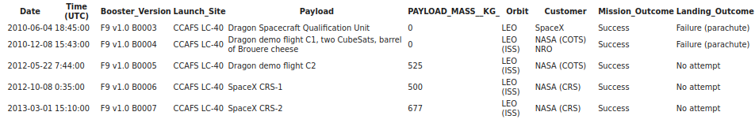
Launch Site Names Begin with 'CCA'
5 records where launch sites begin with `CCA`

Slide 27

Total Payload Mass
Total payload carried by boosters from NASA

Slide 28

Average Payload Mass by F9 v1.1
Average payload mass carried by booster version F9 v1.1

Slide 29

First Successful Ground Landing Date
Dates of the first successful landing outcome on ground pad

Slide 30

Successful Drone Ship Landing with Payload between 4000 and 6000
Names of boosters which have successfully landed on drone ship and had payload mass greater than 4000 but less than 6000

Slide 31

Total Number of Successful and Failure Mission Outcomes
Total number of successful and failure mission outcomes

Slide 32
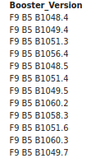
Boosters Carried Maximum Payload
Names of the booster which have carried the maximum payload mass

Slide 33

2015 Launch Records
Failed landing_outcomes in drone ship, their booster versions, and launch site names for in year 2015

Slide 34
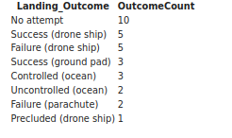
Rank Landing Outcomes Between 2010-06-04 and 2017-03-20
Count of landing outcomes (such as Failure (drone ship) or Success (ground pad)) between the date 2010-06-04 and 2017-03-20, in descending order

Slide 35

Section 3

Slide 36
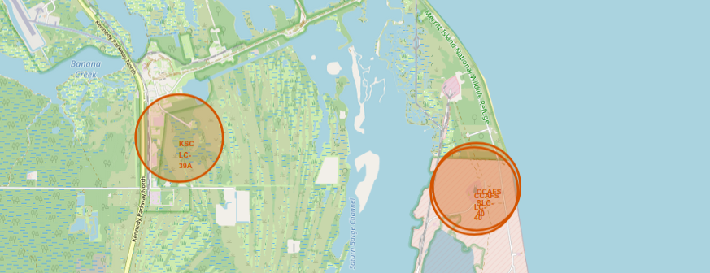
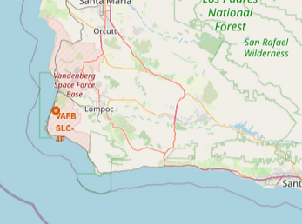
Launch Sites Locations

Slide 37
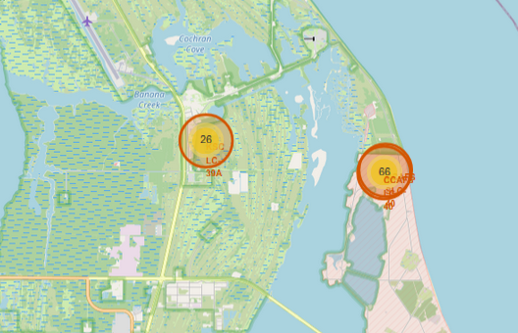
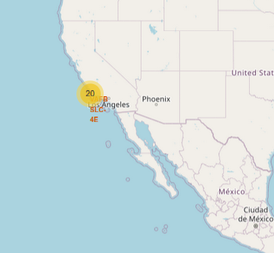
Launch Result x Sites

Slide 38
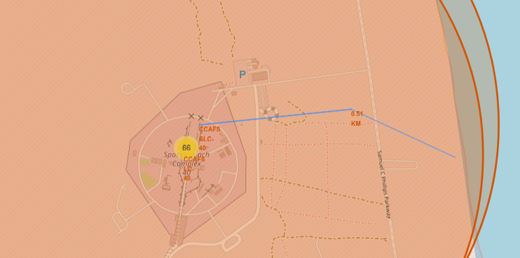
Distance to the Coast

Slide 39

Section 4

Slide 40
<Dashboard Screenshot 1>
Replace <Dashboard screenshot 1> title with an appropriate title
Show the screenshot of launch success count for all sites, in a piechart
Explain the important elements and findings on the screenshot

Slide 41
<Dashboard Screenshot 2>
Replace <Dashboard screenshot 2> title with an appropriate title
Show the screenshot of the piechart for the launch site with highest launch success ratio
Explain the important elements and findings on the screenshot

Slide 42
<Dashboard Screenshot 3>
Replace <Dashboard screenshot 3> title with an appropriate title
Show screenshots of Payload vs. Launch Outcome scatter plot for all sites, with different payload selected in the range slider
Explain the important elements and findings on the screenshot, such as which payload range or booster version have the largest success rate, etc.

Slide 43

Section 5

Slide 44
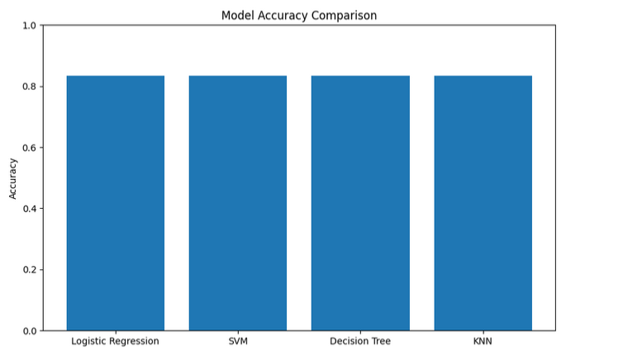
Classification Accuracy

Slide 45
Confusion Matrix

Slide 46
Conclusions
Success Rate by Orbit Type: SpaceX has a 100% success rate for missions targeting ES-L1, GEO, and HEO orbits. The success rates for other orbits, such as ISS, LEO, MEO, and PO, are lower, between 60% and 80%. Missions to GTO have a success rate of about 50%.
Launch Success Yearly Trend: SpaceX's launch success rate has shown a clear upward trend over time. The success rate was 0% from 2010 to 2013, but it rose to approximately 35% in 2014 and 2015. The company achieved its highest success rate in 2019.
Payload vs. Orbit Type: Successful missions have been achieved across a wide range of payload masses and orbit types, including GTO, SSO, and VLEO. Some early missions with lower payload masses resulted in failure.
Model Accuracy: When comparing various classification models, Logistic Regression, SVM, Decision Tree, and KNN all show a similar high accuracy.

Slide 47
Appendix
Include any relevant assets like Python code snippets, SQL queries, charts, Notebook outputs, or data sets that you may have created during this project

Slide 48


